Slide 1
Process Scheduling

Slide 2
Objective
Which process should run and for how long
Scheduler is the basis of multitasking Operating system
A multitasking operating system is one that can simultaneously interleave execution of more than one process
A process may be in runnable or waiting state
Multitasking OS comes in 2 flavours, cooperative multitasking and preemptive multitasking
In preemptive multitasking, the scheduler decides when a process is to cease running and a new process is to begin running.
The act of involuntarily suspending a running process is called preemption
The time a process runs before it is preempted is usually predetermined, and it is called the timeslice of the process
In cooperative multitasking, a process does not stop running until it voluntary decides to do so.
The act of a process voluntarily suspending itself is called yielding
Anyone can monopolize the processor; a hung process that never yields will can lock entire system

Slide 3
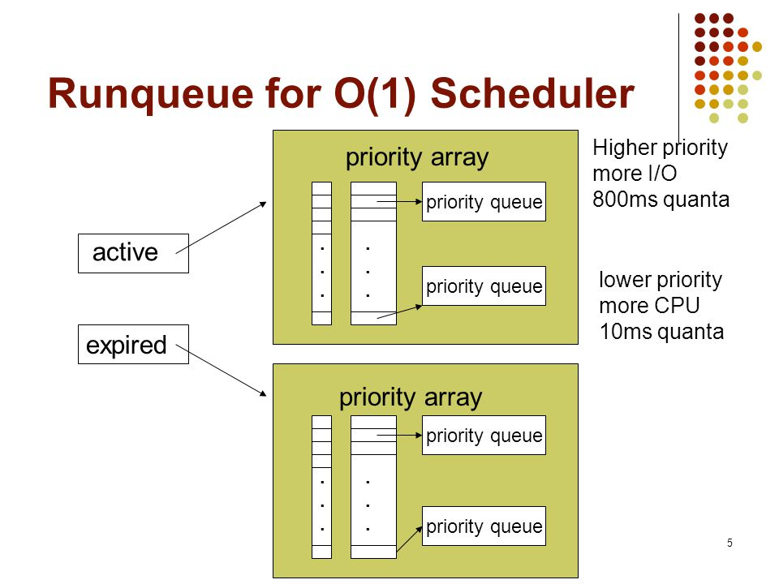
O(1) Scheduler
2.5 series introduced O(1) scheduler or constant time scheduler
O(1) relies on active and expired arrays. Once all tasks in active array are completed, switch the active and expired array pointers.
Failed for latency sensitive applications like interactive processes
In 2.6 developers introduced improved schedulers like Rotating staircase deadline scheduler.

Slide 4
Policy – I/O bound vs processor bound processes
I/O Bound
process that spends much of its time submitting and waiting on I/O requests.
Blocks on I/O events frequently
Example is GUI
Processor Bound
processor-bound processes spend much of their time executing code
Do not block
A scheduler policy for processor-bound processes, therefore, tends to run such processes less frequently but for longer durations
Example: ssh key-gen. MATLAB etc.
Some can be both. Example: window server
The scheduling policy in a system must attempt to satisfy two conflicting goals: fast
process response time (low latency) and maximal system utilization (high throughput).
Linux favours I/O bound processes

Slide 5
Process Priority
Common type of scheduling is priority based scheduling
High priority run before low priority and same priority processes are run in round-robin
Process’s priority is set to influence the scheduling behaviour
Linux kernel implement two priority ranges
The first is the nice value, a number from –20 to +19 with a default of 0. Larger the nice value, lower the priority. Proportion of timeslice allocated to a process depends on the nice value of the process (ps –el)
Real-time priority: configurable and range from 0 to 99. higher the real-time priority values correspond to greater priority. All real-time processes are at a higher priority than normal Processes. In Linux, the real-time priority and nice value are handled separately.
(ps -eo state,uid,pid,ppid,rtprio,time,comm. (- are not realtime))

Slide 6
Timeslice
The timeslice is the numeric value that represents how long a task can run until it is preempted.
How to decide?
I/O bound require smaller timeslice, processor bound require longer timeslice.
Too long timeslice cause poor interactive performance of other processes, too short leads to overhead to switching processes
CFS assign proportion of processor to processes. The timeslice allocated depends on load of the system and the process’s nice value. Nice value affects the proportion allocated.

Slide 7
Process scheduling policy in Action
Consider a text editor and a video controller
Text editor is I/O bound and expect faster response, video controller is processor bound and spend more time on applying codec to raw data. Latency is not a concern
Text editor is given more processor time, it can pre-empt video controller whenever it wakes up.
In Linux, 50% processor is assigned to both, if both have same nice level. Video codec runs until text editor wakes up, scheduler sees that text editor has utilised less CPU even with 50%, so video controller is pre-empted.
“All processes are given fair share”

Slide 8
Priority = 20 + Nice value

Slide 9
Process Scheduling in Unix systems
Modern process schedulers have two common things priority and timeslice.
On Unix, priority is exported to user space as nice values which leads to many problems
Problem 1: Mapping nice value to timeslice.
Eg: Assume default nice value (0) is assigned 100ms and highest nice value(+20) 5ms.
Case 1: P1 nice value =0, P2 nice value = 20
Default priority process receives 100/105 = 20/21 of processor and low priority process, 5/105=1/21 of the processor. Context switch twice in 105ms. Assume its optimal since we choose it.
Case 2: P1 nice value =20, P2 nice value = 20
P1 gets 50% = 5/10 processor and P2 gets 50%. Instead of context switching twice every 105 millisecond, now context switch twice every 10ms.
Case 3: P1 nice value =0 P2 Nice value =0 (some normal process)
P1 gets 50% and P2 gets 50% . But in 100 millisecond increments.

Slide 10
Neither of these timeslice allotments are necessarily ideal.
Usually high nice value processes are background, processor-intensive, while normal priority tasks are foreground user tasks.
Time slice allotment is exactly backward from ideal!
Problem 2: relative nice value to timeslice mapping
Lets consider P1 nice value 0 and P2 nice value 1, the P1=100ms P2 = 95ms.
If their nice values are 18 and 19 then timeslice is 10 and 5ms. (P1 gets twice P2)
Just 1 difference of nice value has significant difference in timeslice depending on starting nice value.
Problem 3: Kernel timers
In most OS, timeslice must be some integer multiple of the timer tick.
Kernel measures timeslice as timer ticks which leads to many problems.
The minimum timeslice has a floor of the period of the timer tick. Might be as high as 10 ms or as low as 1ms
The System timer limits the difference between two timeslices; successive nice values might map to timeslices as much as 10 milliseconds or as little as 1 millisecond apart.
Timeslices change with different timer ticks.
Problem 4: Handling wake up in a priority based scheduler that wants to optimise for interactive tasks. If you might want to give freshly woken-up tasks a priority boost by allowing them to run immediately, even if their timeslice was expired. Although this improves interactive performance in many, if not most, situations, it also opens the door to pathological cases where certain sleep/wake up use cases can game the scheduler into providing one process an unfair amount of processor time, at the expense of the rest of the system.

Slide 11
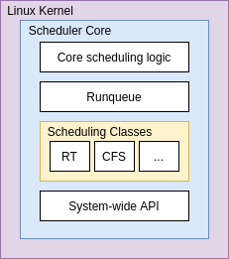
Linux Scheduling Algorithm
Scheduler classes
The Linux scheduler is modular, enabling different algorithms to schedule different types of processes. This modularity is called scheduler classes
The base scheduler code, which is defined in kernel/sched.c, iterates over each scheduler class in order of priority. The highest priority scheduler class that has a runnable process wins, selecting who runs next
The Completely Fair Scheduler (CFS) is the registered scheduler class for normal processes, called SCHED_NORMAL in Linux
A scheduling class defines a common set of functions (via sched_class) that define the behaviour of the scheduler. For example, each scheduler provides a way to add a task to be scheduled, pull the next task to be run, yield to the scheduler, and so on.
Each scheduler class is linked with one another in a singly linked list, allowing the classes to be iterated

Slide 12
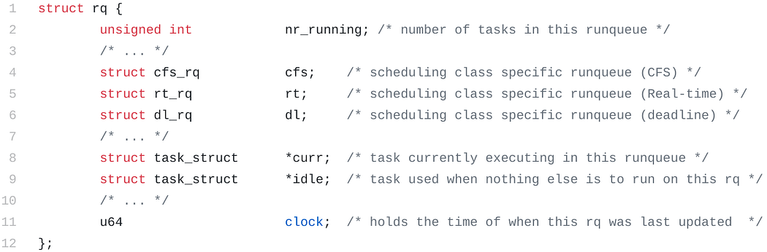
Runqueue
There is one runqueue per CPU

Slide 13
Scheduling classes
Kernel developers realised over the years that trying to combine all different scheduling needs into a single scheduling algorithm would lead to code that would be hard to both understand and maintain. With that in mind, they had to break it down into smaller pieces called scheduling classes.
The basic idea behind it is that each scheduling class would have its own way of:
defining how tasks should be organised.
choosing which of them should be the next task to execute on the CPU.

Slide 14
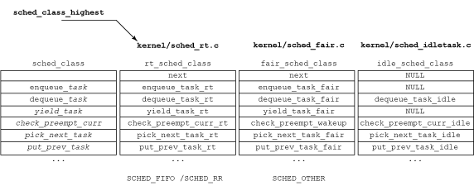
The existing scheduling classes sit on a Linked list that establishes the precedence of each class over the next. Here is a visual representation of this list:
CFS

Slide 15
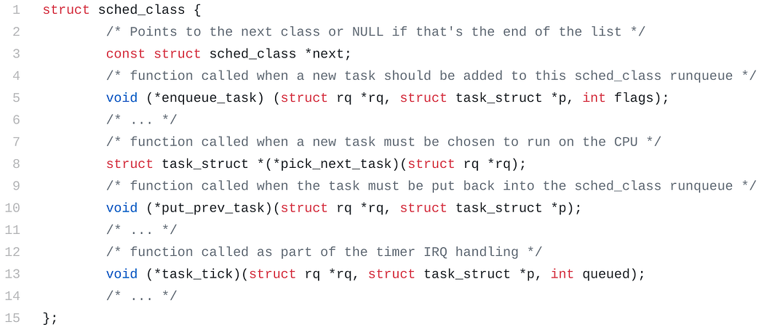

Slide 16
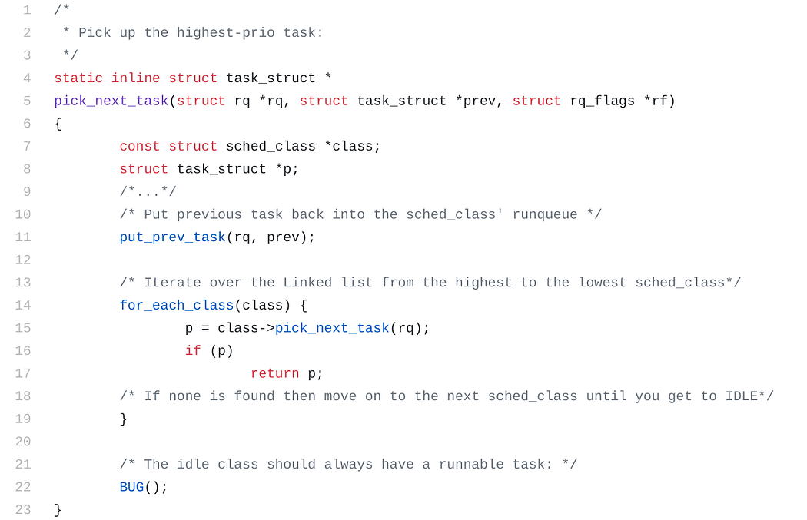
Scheduler core runs pick_next_task

Slide 17
Schedule()
This is one of the most widely used functions in the kernel source code
Part of the public Scheduler Core API and its main purpose is to be called whenever technically applicable to give the scheduler the opportunity to make the decision about what should run on the CPU at a given moment.
The scheduling-clock interrupt
This function called scheduler_tick() is triggered periodically.
The frequency that it happens depends on several factors that involve:
which architecture the kernel is running on.
which CONFIG_* options were enabled during the compilation.
which boot parameters have been used.
whether the CPU has already gotten to the ‘dyntick-idle mode’.

Slide 18
Soln: CFS
Its based on a simple concept
The main idea behind the CFS is to maintain balance (fairness) in providing processor time to tasks.
To determine the balance, the CFS maintains the amount of time provided to a given task in what’s called the virtual runtime.
The smaller a task’s virtual runtime—meaning the smaller amount of time a task has been permitted access to the processor—the higher its need for the processor.
The CFS also includes the concept of sleeper fairness to ensure that tasks that are not currently runnable (for example, waiting for I/O) receive a comparable share of the processor when they eventually need it.

Slide 19
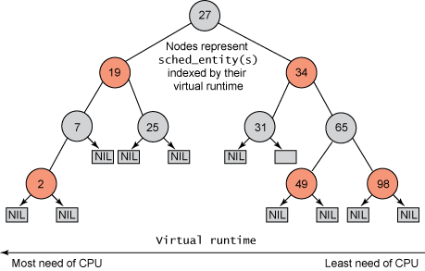
Earlier, tasks were maintained in runqueue, CFS maintains it in the form of red-black tree.
A red-black tree is a tree with a couple of interesting and useful properties.
First, it’s self-balancing, which means that no path in the tree will ever be more than twice as long as any other.
Second, operations on the tree occur in O(log n) time (where n is the number of nodes in the tree). This means that you can insert or delete a task quickly and efficiently.
With tasks (represented by sched_entity objects) stored in the time-ordered red-black tree, tasks with the gravest need for the processor (lowest virtual runtime) are stored toward the left side of the tree, and tasks with the least need of the processor (highest virtual runtimes) are stored toward the right side of the tree.
Red-black trees in 4 minutes — The basics - YouTube

Slide 20
The scheduler then, to be fair, picks the left-most node of the red-black tree to schedule next to maintain fairness.

Slide 21
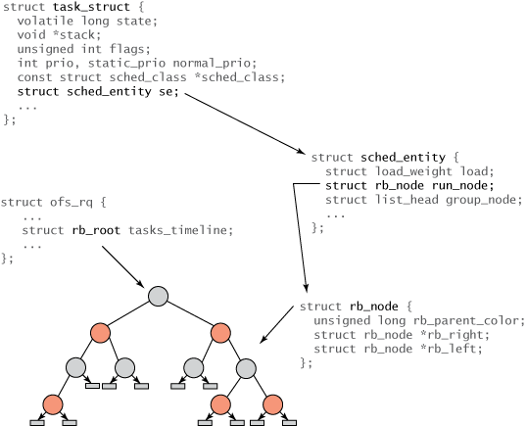
Structure hierarchy for tasks and the red-black tree

Slide 22
All process are represented with task_struct
The root of the tree is referenced via the rb_root element from the cfs_rq structure
Each node in the red-black tree is represented by an rb_node, which contains nothing more than the child references and the color of the parent.
The rb_node is contained within the sched_entity structure, which includes the rb_node reference, load weight, and a variety of statistics data. Most importantly, the sched_entity contains the vruntime (64-bit field), which indicates the amount of time the task has run and serves as the index for the red-black tree.
Finally, the task_struct sits at the top, which fully describes the task and includes the sched_entity structure.

Slide 23
Red Black Tree
Red-black trees in 4 minutes — The basics - YouTube
Red/Black Tree Visualization (csubak.edu)

Slide 24
Example
Task | Nice value | Weight | Ratio | Timeslice
T1 | -10 | 9548 | 0.6753 | 4.05 (appr 5)
T2 | -5 | 3121 | 0.2208 | 1.3 (appr 2ms)
T3 | 0 | 1024 | 0.0724 | .434 (appr 1ms)
T4 | 5 | 335 | 0.0237 | .142 (appr 1ms)
T5 | 10 | 110 | 0.0078 | .04 (appr 1ms)
Total |  | 14138 | 1.0
Time slice for a task i =
Target Latency * weight/(sum of all weights)
= Target latency * ratio
Above TL is assumed as 6ms
Weight = 1024/(1.25)^(nice)
Eg: If nice value = -10
Then weight = 1024/(1.25)^(-10) = 9548
If nice value = -5, weight = 1024/(1.25)^(-5) = 3121

Slide 25
Targeted Latency
CFS uses a target latency which is a portion of time the threads will share. Smaller targets yield better interactivity and a closer approximation to perfect multitasking, at the expense of higher switching costs and thus worse overall throughput
Note as the number of runnable tasks approaches infinity, the proportion of allotted processor and the assigned timeslice approaches zero. As this will eventually result in unacceptable switching costs, CFS imposes a floor on the timeslice assigned to each process. This floor is called the minimum granularity. By default it is 1 millisecond.
CFS uses a target latency which is a portion of time the threads will share. Suppose the target latency is 20 ms. Then a thread gets a timeslice which is a fraction of those 20 ms calculated as its weight divided by the sum of weights.

Slide 26
The variable vruntime represents the process runtime so far.
It’s not an absolute time but weighted by the number of runnable processes.
The highest priority process is the process with smallest value of vruntime.
The CFS Scheduler maintains a red-black tree, sorted by the value of vruntime. So, the process the CFS scheduler selects is the leftmost node in the tree.
To avoid having to traverse the tree too often, this node is cached as cfs_rq->rb_leftmost

Slide 27

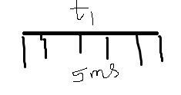
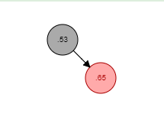
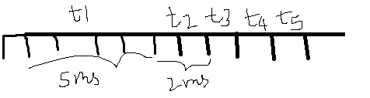
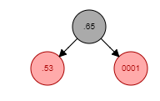
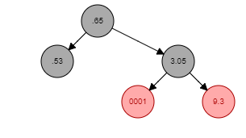
Vruntime calculation: The variable vruntime represents the process runtime so far.
update_curr() calculates the execution time of the current process and stores that value in delta_exec
Vruntime+ = delta_exec * (NICE_0_LOAD / curr->load.weight)
Since all processes are normal processes, we take NICE_0_LOAD is default = nice value of 0 = 1024 weight.
Run T1
vruntime = 1024/9548*5ms = 0.53
Insert into red-black tree
Run T2
Vruntime = 1024/3121* 2 = 0.65
Run T3
Vruntime = 1024/1024 * 1 = 1
Run T4
Vruntime = 1024/335 *1 = 3.05
Run T5
Vruntime = 1024/110*1 = 9.3

Slide 28
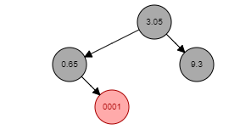
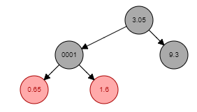
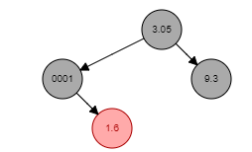
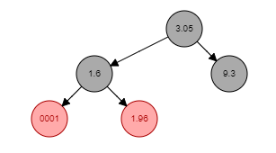
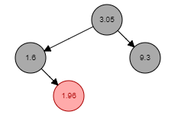
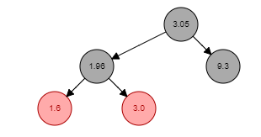
Next time scheduler selects T1 as it is the leftmost in the Red black tree and deletes the node.
Vruntime of T1 is (leftmost)
Delete T1, schedule and insert new vruntime
=1024/9548*10 = 1.07+0.53 = 1.6
Schedule T2 (leftmost) and delete node
Vruntime of T2 = 1024/3121*4 = 1.31+0.65 =1.96
Schedule T3 and delete node
Vruntime of T3 = 1024/1024*2 = 2+1=3
To avoid having to traverse the tree too often, this node is cached as cfs_rq->rb_leftmost.

Slide 29
The Linux Scheduling Implementation kernel/sched_fair.c.
We discuss four components of CFS:
Time Accounting
Process Selection
The Scheduler Entry Point
Sleeping and Waking Up

Slide 30
Time accounting
All process schedulers must account for the time that a process runs.
On each tick of the system clock, the timeslice is decremented by the tick period. When the timeslice reaches zero, the process is preempted in favor of another runnable process with a nonzero timeslice.
CFS uses the scheduler entity structure, struct sched_entity, defined in <linux/sched.h>, to keep track of process accounting
struct sched_entity {
struct load_weight load; //weight related to prioriy
struct rb_node run_node; //red-black tree node
struct list_head group_node; //process group
unsigned int on_rq;
u64 exec_start; //time when process started
u64 sum_exec_runtime; //total running time of the process
u64 vruntime; //virtual runtime
u64 prev_sum_exec_runtime; //the total running time of the process in the last scheduling cycle
u64 last_wakeup;
u64 avg_overlap;
u64 nr_migrations;
u64 start_runtime;
u64 avg_wakeup;
/* many stat variables elided, enabled only if CONFIG_SCHEDSTATS is set */
};
1) Call the update_curr() function, calculate the execution time of the current process, and store the result in the variable delta_exec;
2) Pass delta_exec as a parameter to the _update_curr() function, which will weight the running time according to the total number of processes currently running;
3) Add the weight value to the vruntime of the currently running process to get the new vruntime value.
Update_curr() function is called periodically by the system timer, regardless of whether the process is in a runnable state or blocked in a non-runnable state. In this way, vruntime can accurately measure the running time of a given process, and know who should be the next process to be run.

Slide 31
Vruntime updation
static inline void __update_curr(struct cfs_rq *cfs_rq, struct sched_entity *curr,
unsigned long delta_exec)
{
unsigned long delta_exec_weighted;
schedstat_set(curr->exec_max, max((u64)delta_exec, curr->exec_max));
curr->sum_exec_runtime += delta_exec;
schedstat_add(cfs_rq, exec_clock, delta_exec);
delta_exec_weighted = calc_delta_fair(delta_exec, curr);
curr->vruntime += delta_exec_weighted;
update_min_vruntime(cfs_rq);
}
The function update_curr(), defined in kernel/sched_fair.c, manages this vruntime accounting:
static void update_curr(struct cfs_rq *cfs_rq)
{
struct sched_entity *curr = cfs_rq->curr;
u64 now = rq_of(cfs_rq)->clock;
unsigned long delta_exec;
if (unlikely(!curr))
return;
/*
* Get the amount of time the current task was running
* since the last time we changed load (this cannot
* overflow on 32 bits):
*/
__update_curr(cfs_rq, curr, delta_exec);
curr->exec_start = now;
if (entity_is_task(curr)) {
struct task_struct *curtask = task_of(curr);
trace_sched_stat_runtime(curtask, delta_exec, curr->vruntime);
cpuacct_charge(curtask, delta_exec);
account_group_exec_runtime(curtask, delta_exec);
}
}
delta_exec = (unsigned long)(now - curr->exec_start);
if (!delta_exec)
return;

Slide 32
Process Selection (Picking the next task)
Processor picks the task with smallest vruntime.
static struct sched_entity *__pick_next_entity(struct cfs_rq *cfs_rq)
{
struct rb_node *left = cfs_rq->rb_leftmost;
if (!left)
return NULL;
return rb_entry(left, struct sched_entity, run_node);
}
Note that __pick_next_entity() does not actually traverse the tree to find the leftmost node, because the value is cached by rb_leftmost. If the function returns NULL, there is no leftmost node, and thus no nodes in the tree. In that case, there are no runnable processes, and CFS schedules the idle task.

Slide 33
Adding Processes to the Tree – enqueue_entity
Called when a task enters a runnable state. It puts the scheduling entity (task) into the red-black tree and increments the nr_running variable.
link = rb_node
parent = NULL
bool leftmost = true
When link cycle
parent = link
entry = rb_entry(parent, structsched_entity, run_node)
If entity_before(se, entry) Then //If less then left
link = rb_left
Else
link = rb_right
leftmost = false
rb_link_node( & run_node, parent, link) //insert to rb tree
rb_insert_color_cached( & run_node, & tasks_timeline, leftmost) //If leftmost Then rb_leftmost = node (cache it)

Slide 34
Removing a process from the tree
When a process blocks or terminates
Dequeue_entity is called → rb_erase
Rb_erase updates rb_leftmost and invokes rb_next

Slide 35
Schedular entry point
Schedule() function:
Generic w.r.t schedular classes
Calls pick_next_task_fair() : goes through each schedular class starting with the highest priority and selects the highest priority process in the highest priority class
Schedule() is called in exit() syscall and other places as well for scheduling

Slide 36
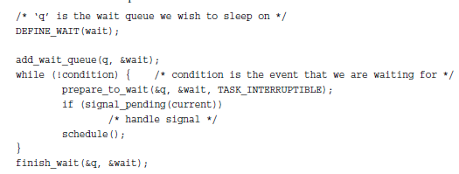
Sleeping and waking up
A common reason to sleep is file I/O—for example, the task issued a read() request on a file, which needs to be read in from disk. As another example, the task could be waiting for keyboard input.
Process removes from RB tree and puts itself in wait queue
Calls schedule()
When runnable, removed from wait queue and puts itself into RB tree
TASK_INTERRUPTIBLE and TASK_UNINTERRUPTIBLE are the states

Slide 37
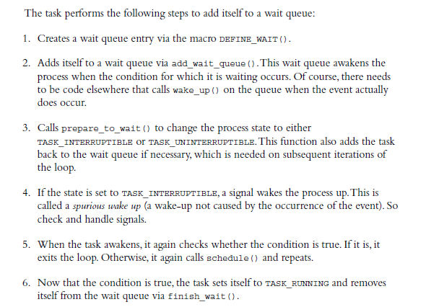

Slide 38
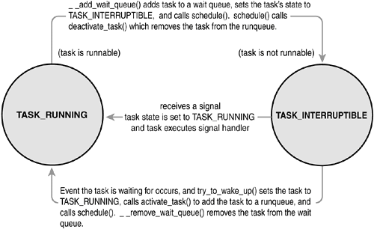
Waking up
wake_up(), which wakes up all the tasks waiting on the given wait queue. It calls try_to_wake_up(), which sets the task’s state to TASK_RUNNING calls enqueue_task(), adds to RB tree and sets need_resched

